Slide 1
Predicting Car Mileage based on specifications
Konrad Siebor

Slide 2
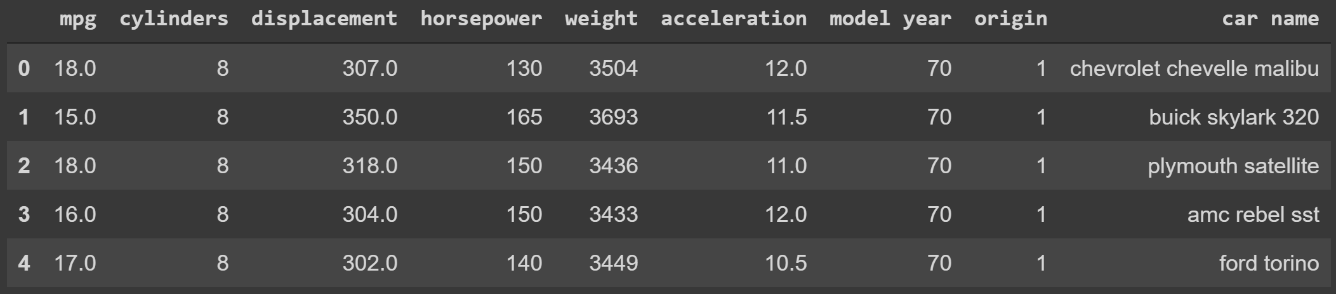
Mileage Data Set Overview
Available on Kaggle
397 unique cars with associated stats
8 features (7 categorical and 1 quantitative field)
Label: miles per gallon (mpg)
Country of Origin*
mpg: Continuous Float Value
*1 = America, 2 = Europe, 3 = Asia

Slide 3
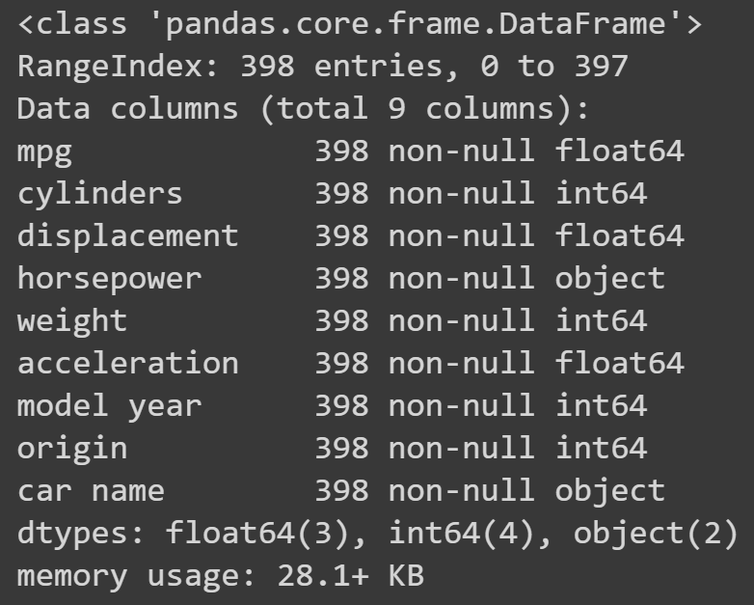
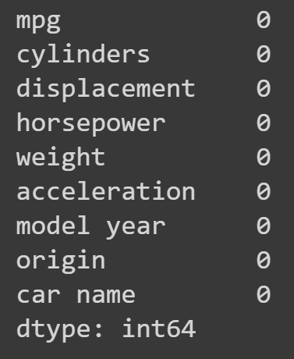
Data Clean-Up
Data Overview
No null data in any Fields!

Slide 4
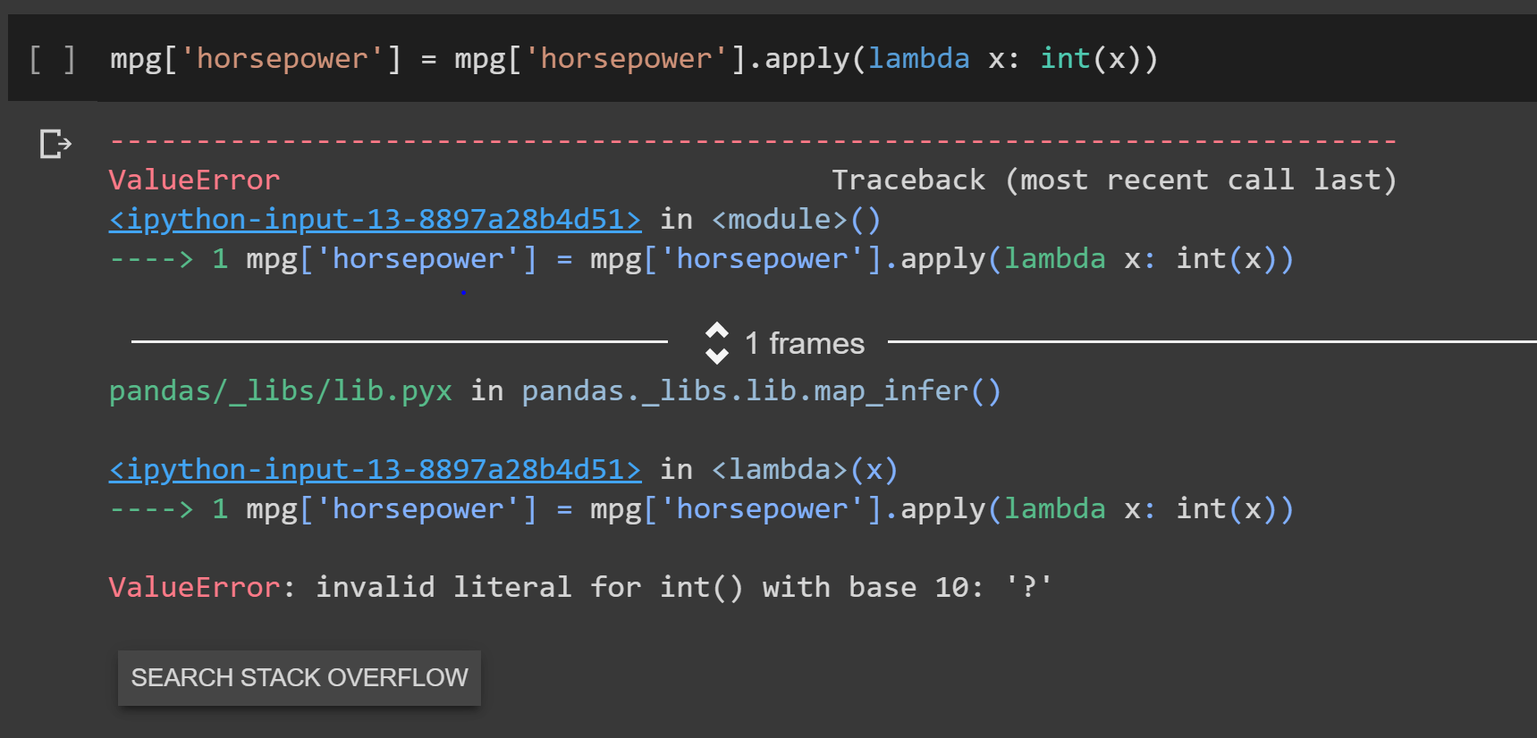
However...
Instead of using null values, the creators of the data set used ‘?’

Slide 5
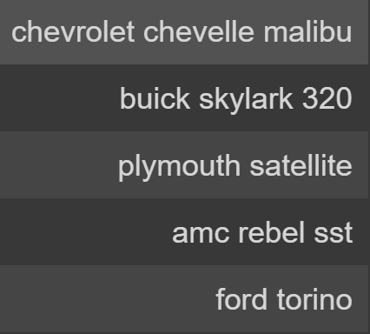
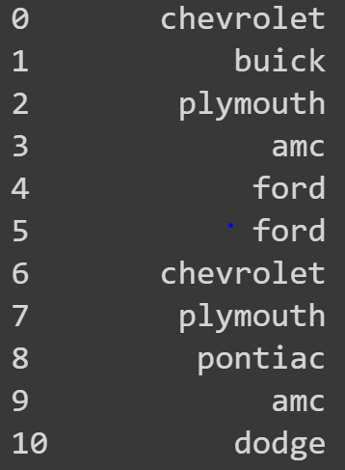
Feature Extraction

Slide 6
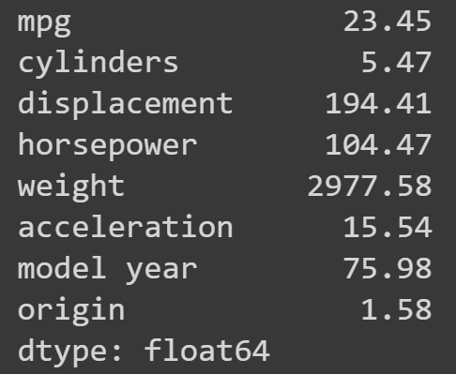
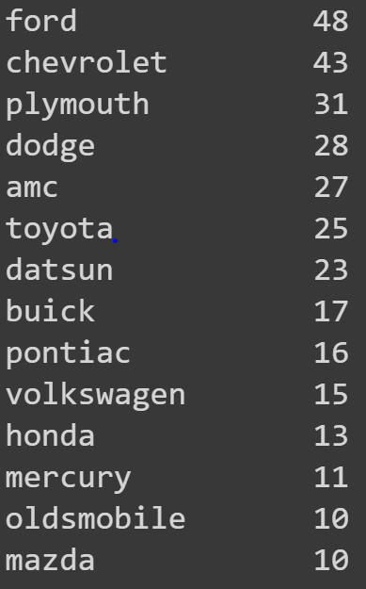
Numerical Analysis
Mean Values
Make Counts

Slide 7
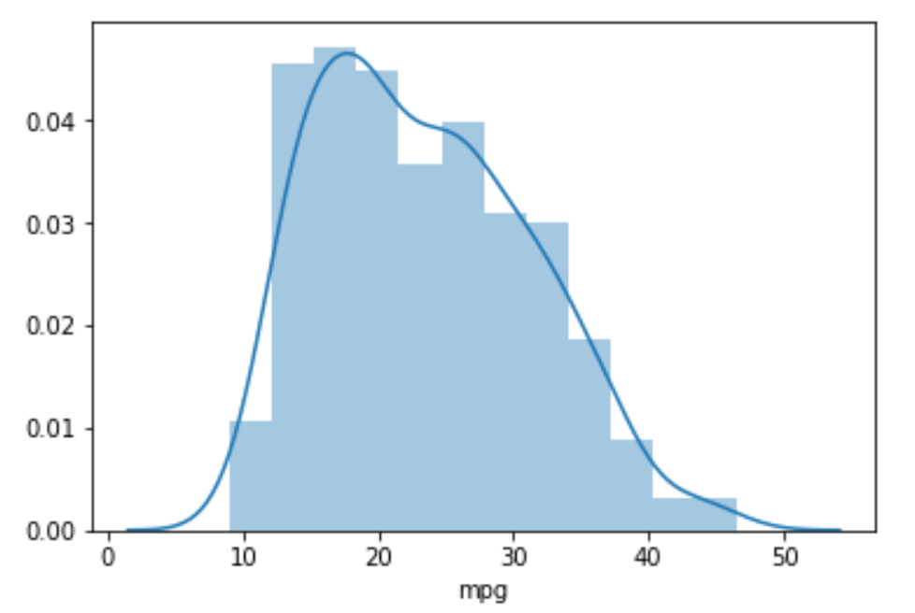
Exploratory Visualizations
Distribution of mpg

Slide 8
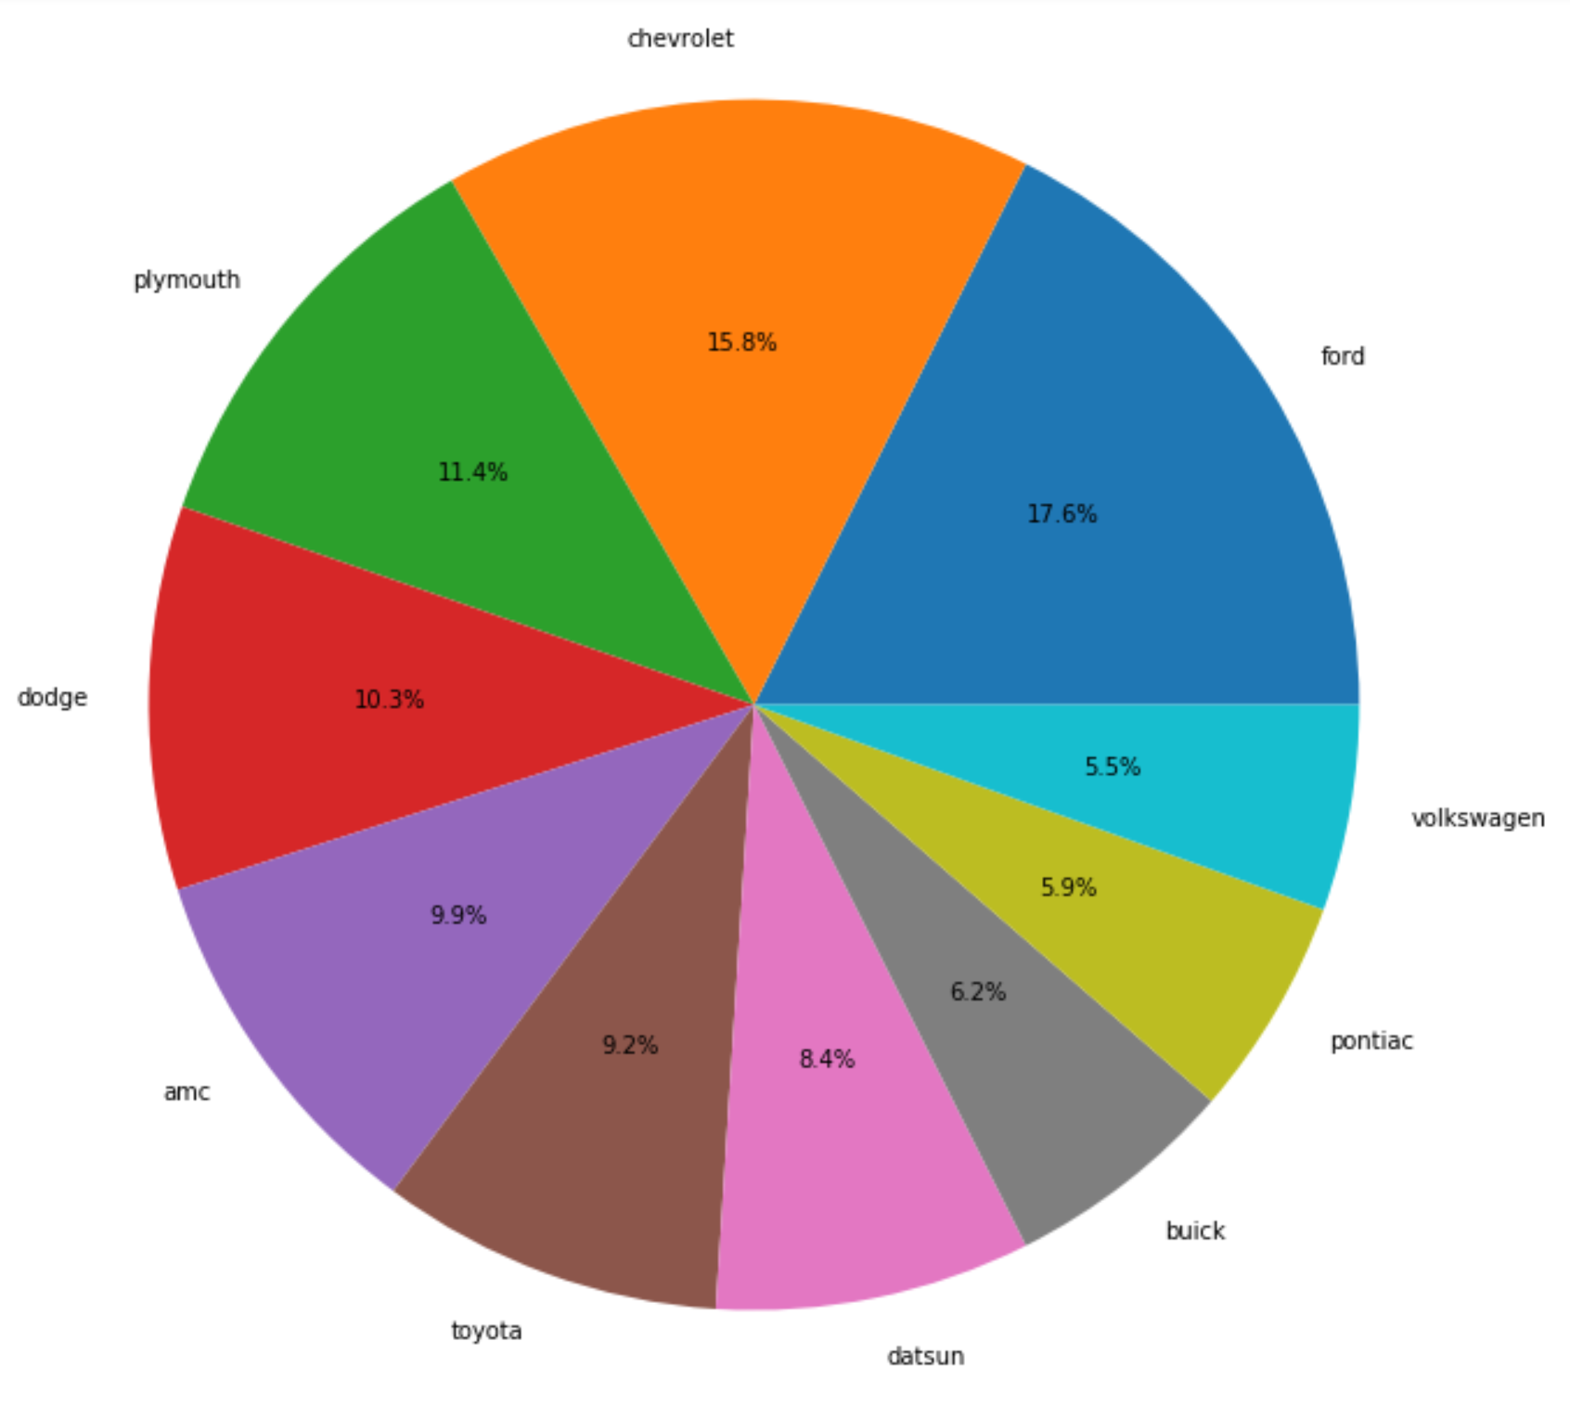
Exploratory Visualizations
Relative proportion of car manufacturers

Slide 9
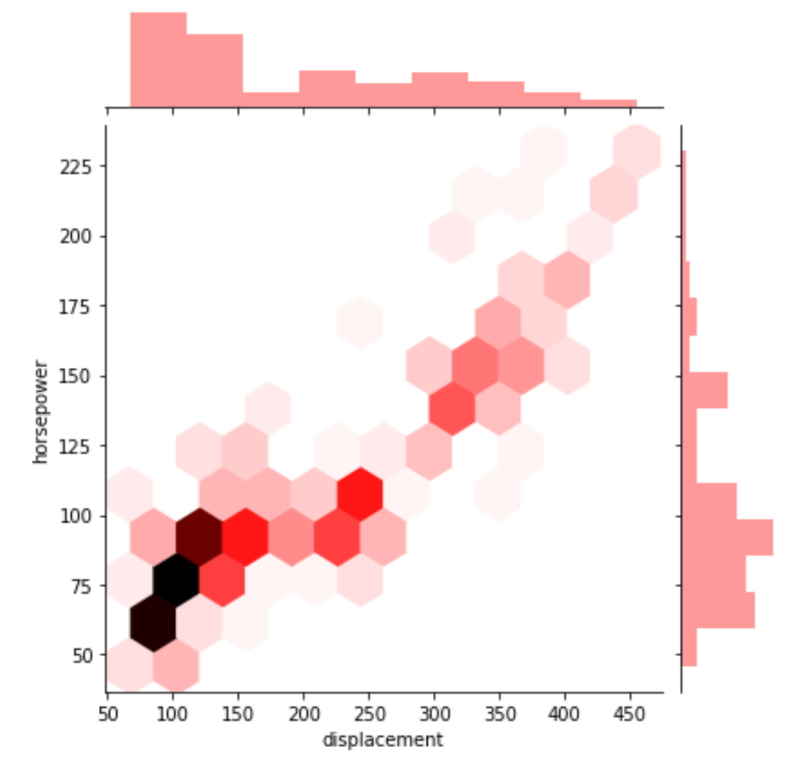
Exploratory Visualizations
Horsepower positively correlated with displacement
Large density of cars with 50-100 horsepower and 50-150 displacement

Slide 10
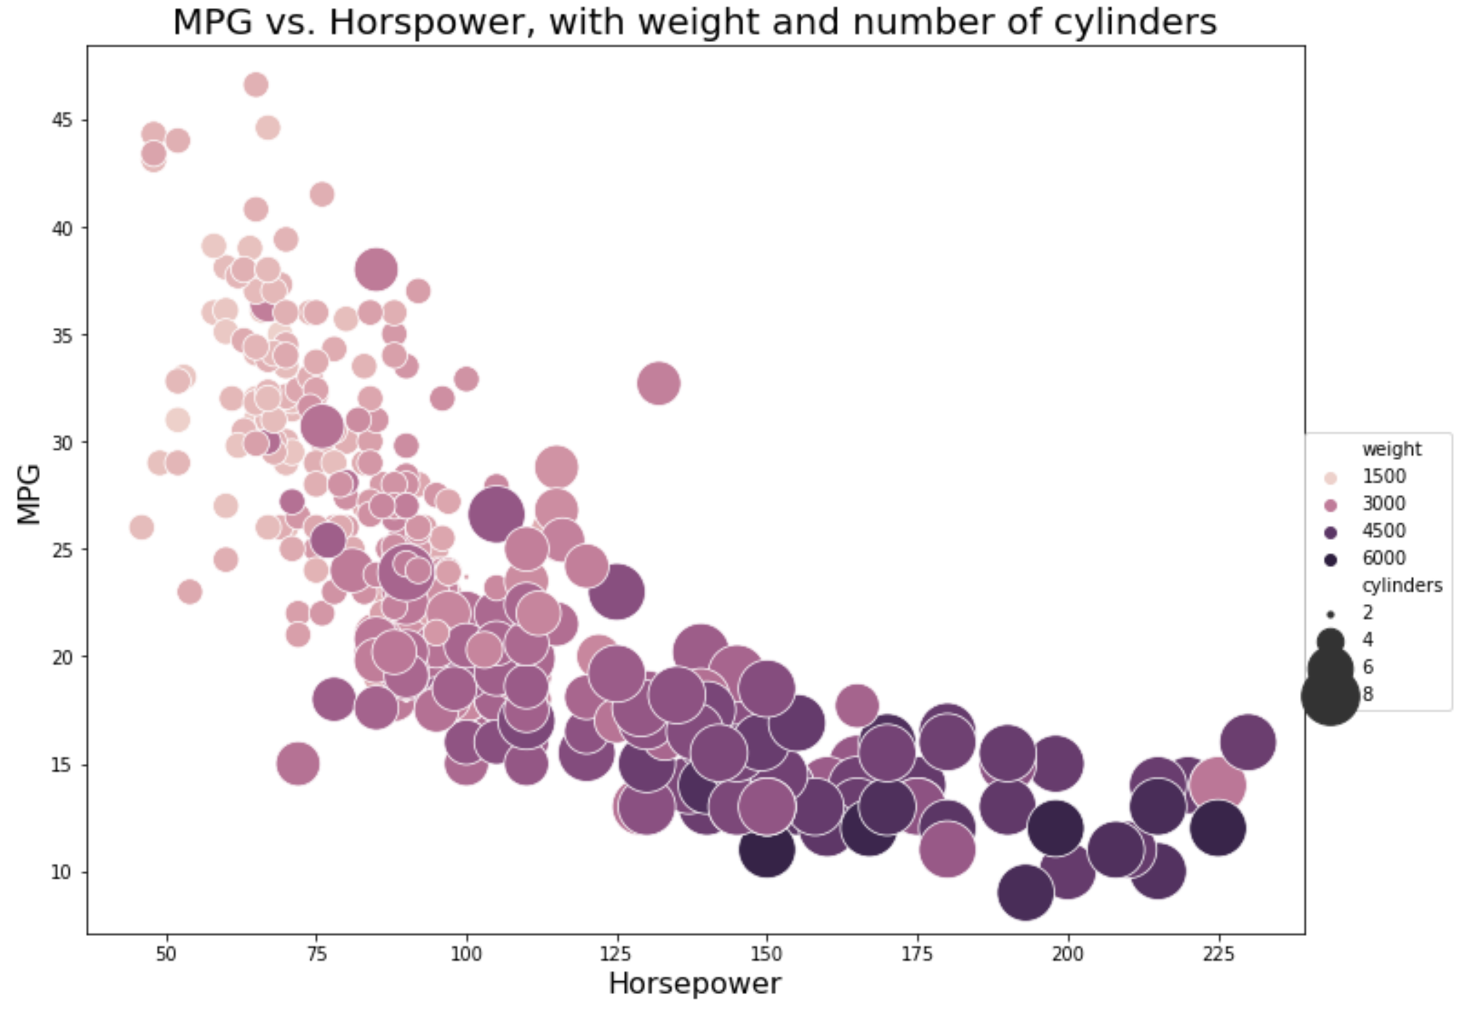
Exploratory Visualizations
As horsepower, weight, and cylinder count increase, the mpg decreases in a decay-like trend

Slide 11
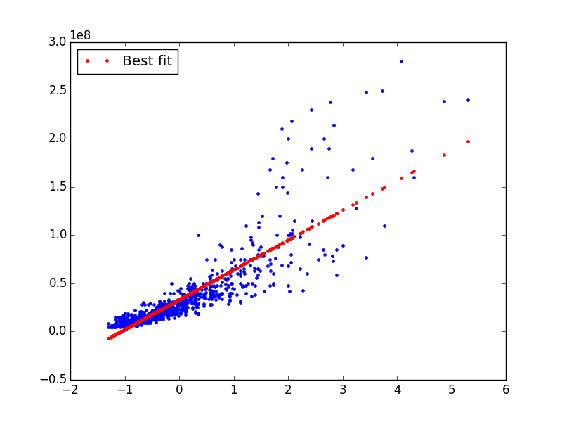
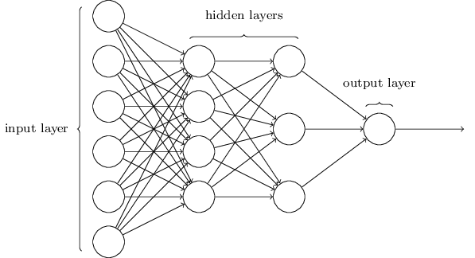
Machine Learning Algorithms
Attempting to predict continuous mpg label from continuous features
Algorithms:
Multivariate linear regression
MLP Regressor

Slide 12
Linear Regression
Import libraries
Train/Test Split
Instantiate Model
Evaluate performance
Predict on test data
Train on training data

Slide 13
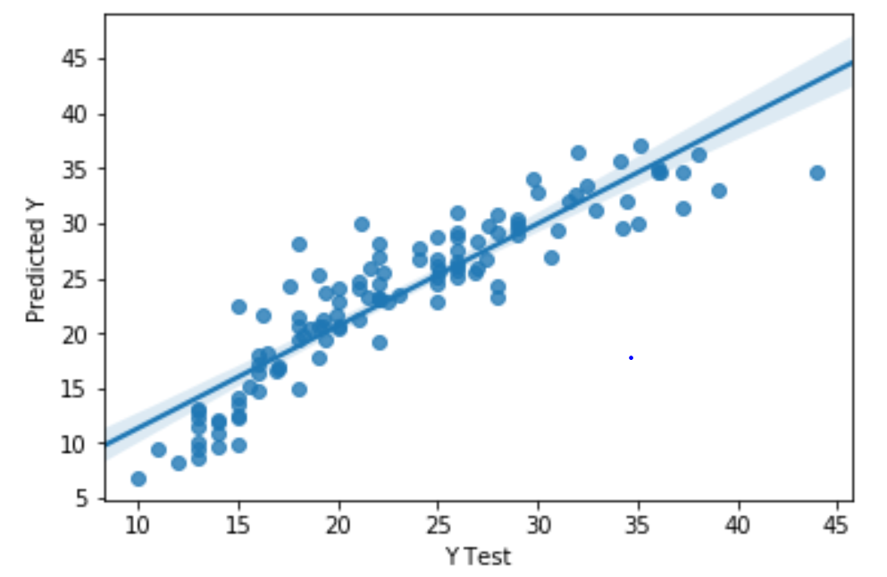
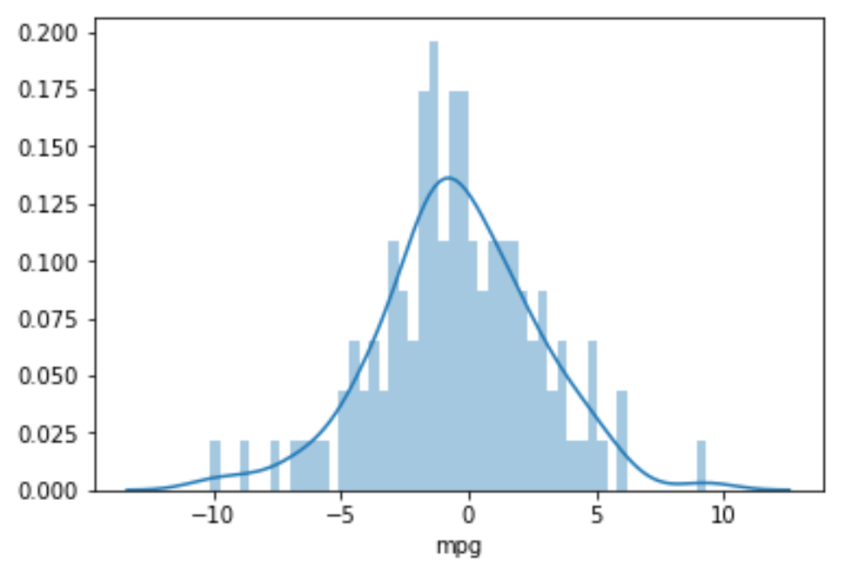
Performance
Predicted mpg vs actual mpg
Distribution of residuals

Slide 14
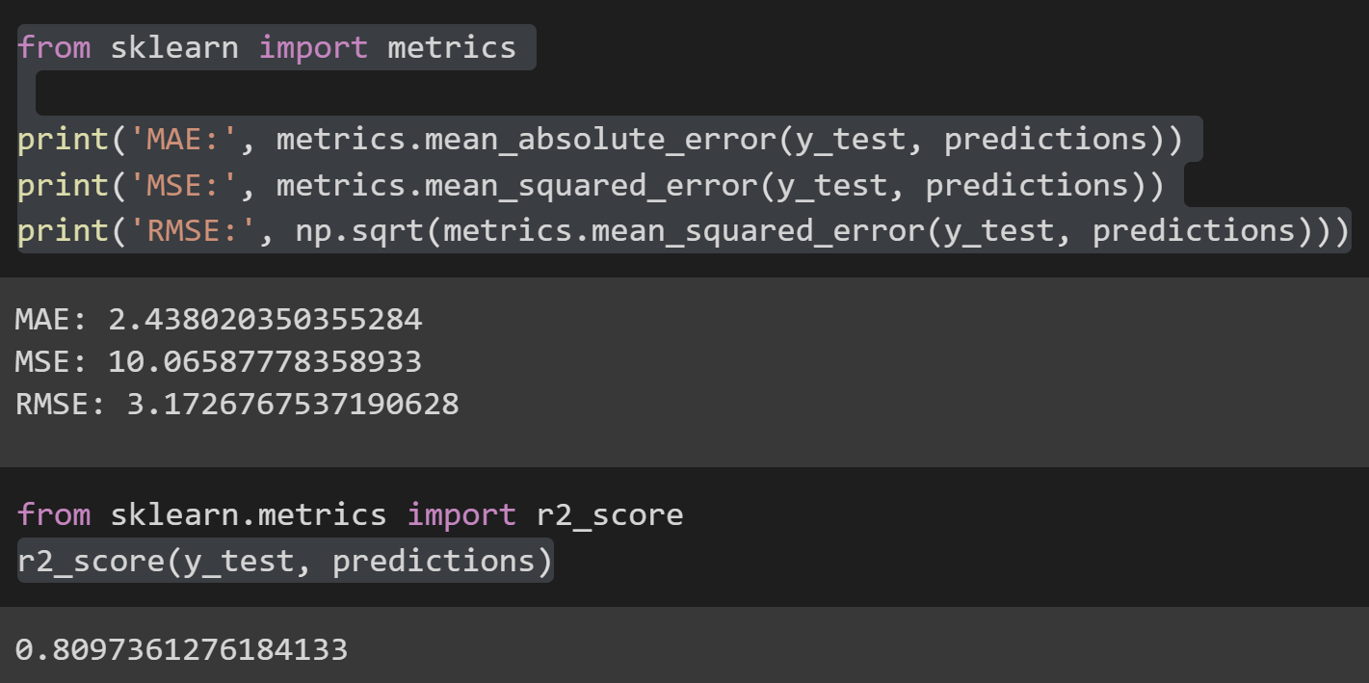
Performance
Quantified through four metrics: mean absolute error (MAE), mean squared error (MSE), root mean squared error (RMSE), and r²

Slide 15
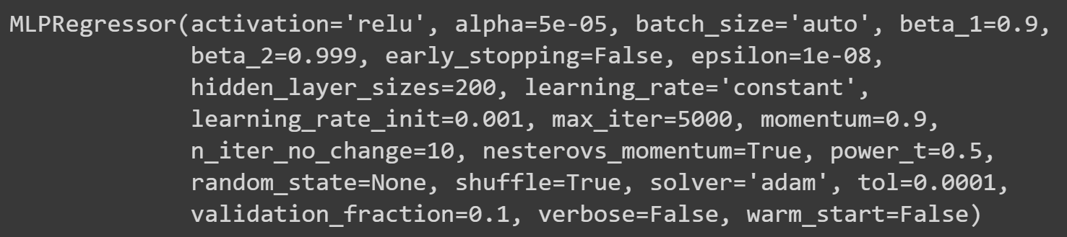
MLP Regressor
Outputs continuous variable rather than discrete classifications
Far more parameters to tinker with: learning rate, iterations, number of hidden layers, etc.

Slide 16
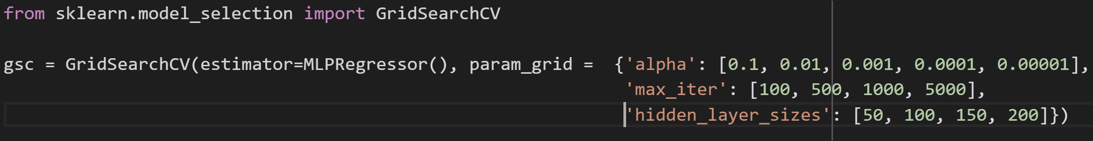
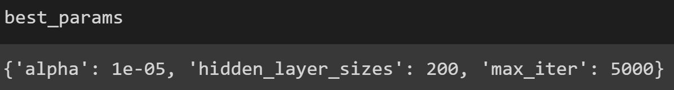
Grid Search
Define parameter space of possible values you think could work
Run an automated grid search algorithm that tries all the combinations and outputs the best performing parameters

Slide 17
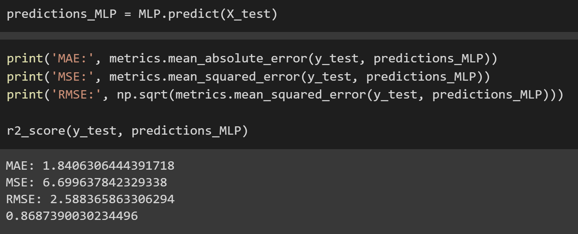
Performance

Slide 18
Improvements
Further feature engineering (power-weight ratio, etc)
Extend gridsearch in MLPRegressor to more parameters
Use more powerful packages → Tensor Flow
Repeat with a larger dataset

